Slide 1
HOTEL MANAGEMENT SYSTEM
Presented By:
Meher Jain
Radhika M. Paryekar
Subir Padhee

Slide 3
DESIGN PATTERNS
Factory Pattern
Singleton
MVC

Slide 4
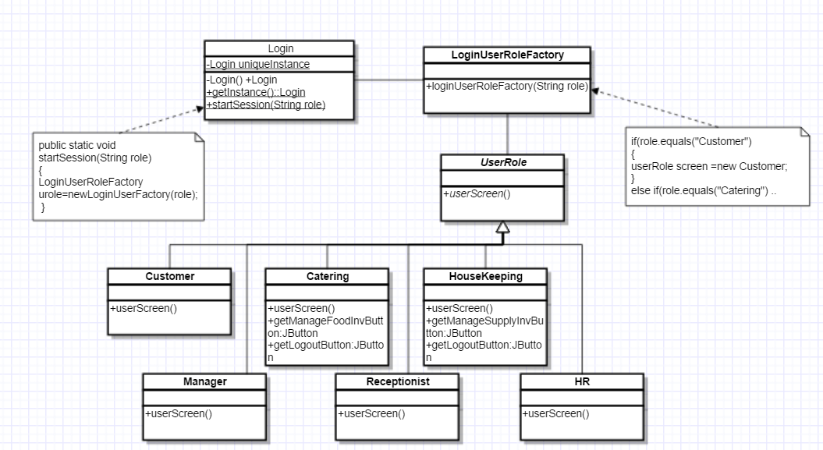
FACTORY PATTERN

Slide 5
SINGLETON PATTERN

Slide 6
MVC

Slide 7
FUTURE DESIGN PATTERNS
Memento-To save customer/employee preference
Flyweight -To store picture of rooms and menu
Command- To undo user selection

Slide 8
Anti Patterns
BLOB –
Initially had a Single Controller in Class Diagram
Separated the controller into different controllers related to specific task

